Slide 1
Signal and Noise in Measurement Systems
Sensors and Actuators – Joel von Rotz

Slide 2
Overview
Signal Types
Statistical Representation of random signals
Effects of noise and interference on measurement circuits
Noise sources and coupling mechanisms
Methods of reducing effects of noise and interference

Slide 3
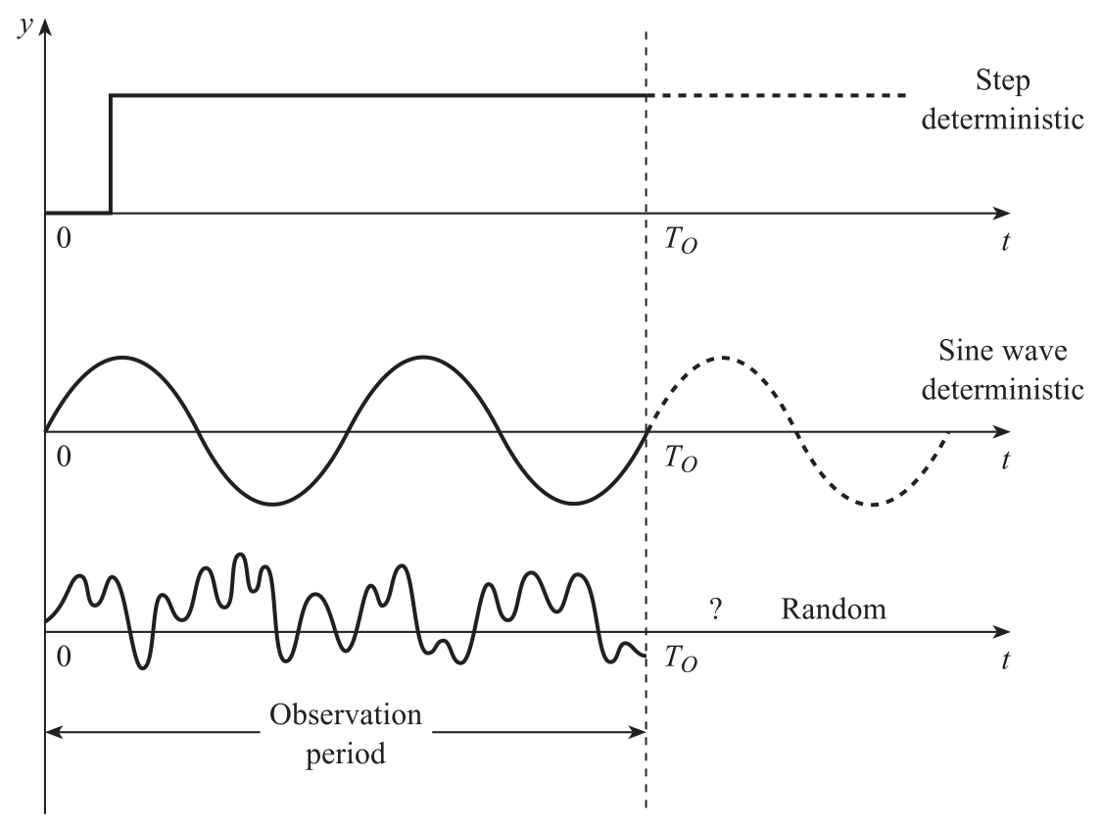
Determenistic & Random
Notes:
Output signals, for example a step or sine wave, are deterministic signals, since after enough observation (one period), the signal can be predicted at any future point of time.
Input signals are viewed as random, since the format of an input signal is unknown, hence the measured signal can’t be extrapolated at any future point of time.

Slide 4
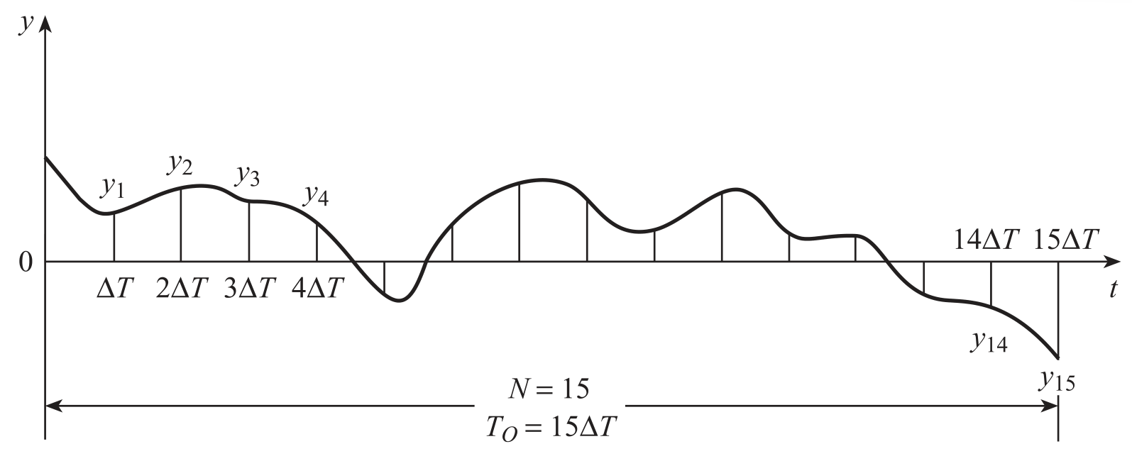


Statistical Representation of Random Signals
$$y\left(t\right)→y\left[k\right]$$
$$f_{sample}> 2⋅f_{signal}$$
Notes:
Since the signal is random, it can’t be expressed as a continuous function. The measuring is done in discreet steps (when using microcontrollers) and therefore the signal is expressed as a series of values $y\left[k\right]$. Using these values, the probability of signals can be calculated.

Slide 5


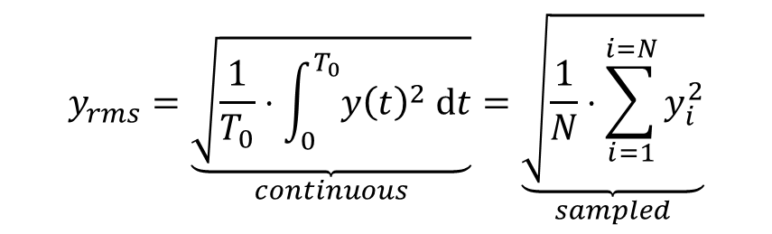
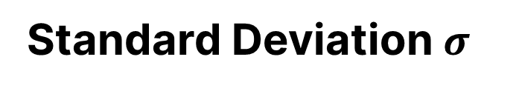
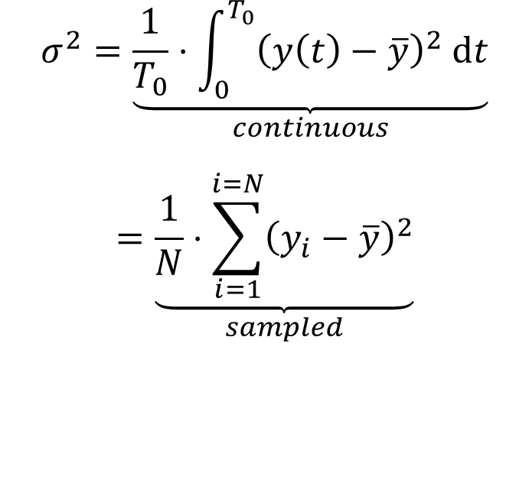
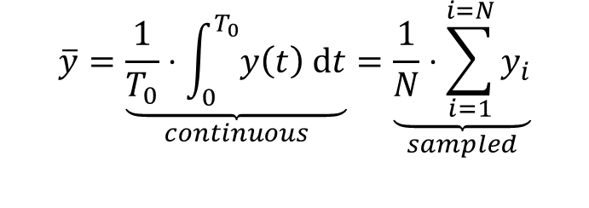
Mean $\overline{y}$
Standard Deviation $σ$
$$\overline{y}=\underset{continuous}{\underbrace{\frac{1}{T_{0}}⋅\int_{0}^{T_{0}}{y\left(t\right) dt}}}=\underset{sampled}{\underbrace{\frac{1}{N}⋅\sum_{i=1}^{i=N}{y_{i}}}}$$
$$σ^{2}=\underset{continuous}{\underbrace{\frac{1}{T_{0}}⋅\int_{0}^{T_{0}}{{\left(y\left(t\right)−\overline{y}\right)}^{2} dt}}}$$
$$=\underset{sampled}{\underbrace{\frac{1}{N}⋅\sum_{i=1}^{i=N}{{\left(y_{i}−\overline{y}\right)}^{2}}}}$$
Case $\overline{y}=0→σ=y_{rms}$:
$$y_{rms}=\underset{continuous}{\underbrace{\sqrt{\frac{1}{T_{0}}⋅\int_{0}^{T_{0}}{y{\left(t\right)}^{2} dt}}}}=\underset{sampled}{\underbrace{\sqrt{\frac{1}{N}⋅\sum_{i=1}^{i=N}{y_{i}^{2}}}}}$$
Notes:
Since the signal is random, it can’t be expressed as a continuous function. The measuring is done in discreet steps (when using microcontrollers) and therefore the signal is expressed as a series of values $y\left[k\right]$. Using these values, the probability of signals can be calculated.

Slide 6
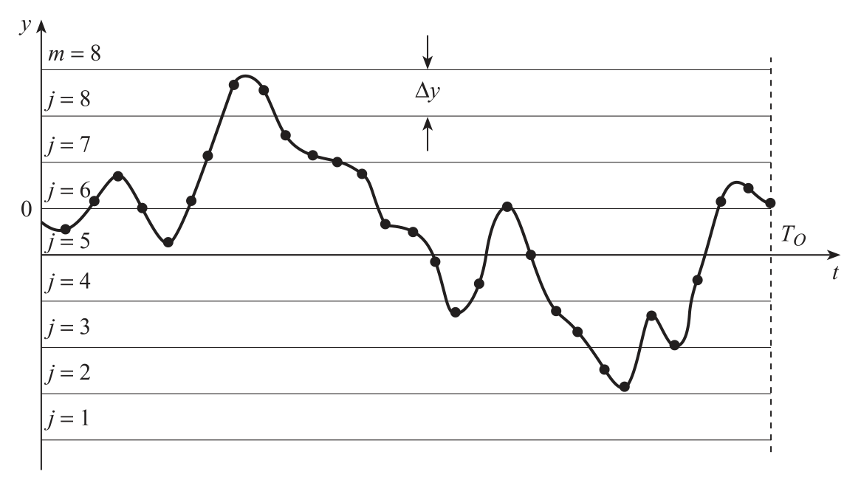
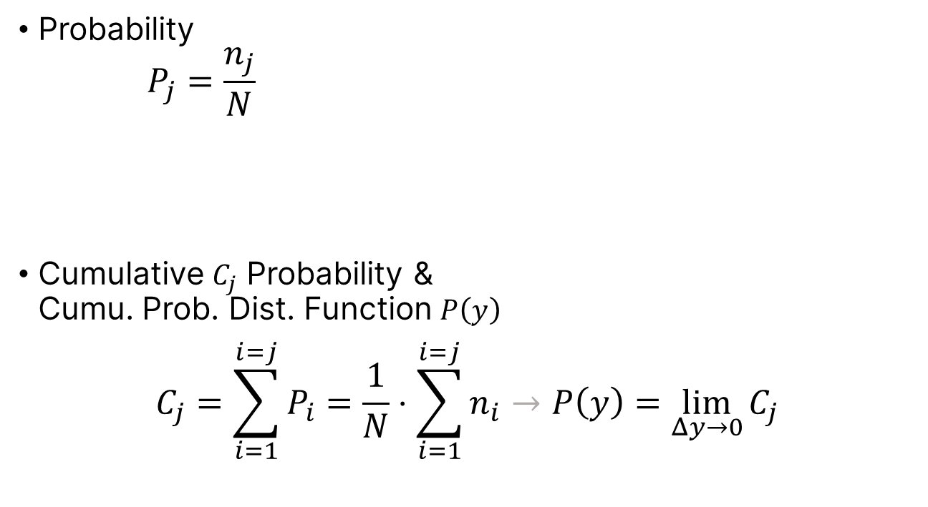
Probability Density Function Statistical Representation of Random Signals
Probability
$$P_{j}=\frac{n_{j}}{N}$$
Cumulative $C_{j}$ Probability & Cumu. Prob. Dist. Function $P\left(y\right)$
$$C_{j}=\sum_{i=1}^{i=j}{P_{i}}=\frac{1}{N}⋅\sum_{i=1}^{i=j}{n_{i}}→P\left(y\right)=\lim_{Δy→0}{C_{j}}$$
Notes:
Probability $P_{j}=\frac{n_{j}}{N}$ ($N$: total sample $n_{j}$: amount of samples in $j$th section)

Slide 7
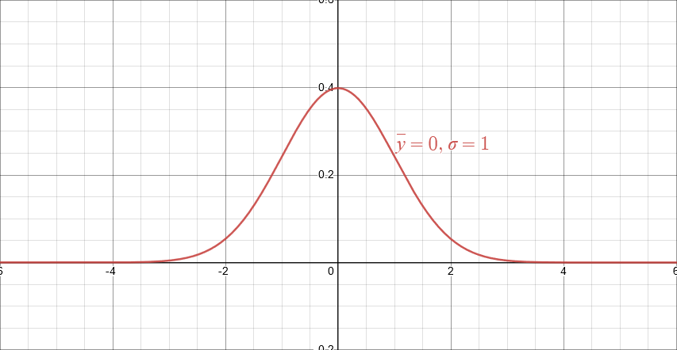

Normal Probability Density Function Statistical Representation of Random Signals
$$p\left(y\right)=\frac{1}{σ⋅\sqrt{2π}}⋅\exp\left[−\frac{{\left(y−\overline{y}\right)}^{2}}{2⋅σ^{2}}\right]$$
Notes:
For the distribution of amplitude signals, the normal probability distribution function is sufficient.

Slide 8
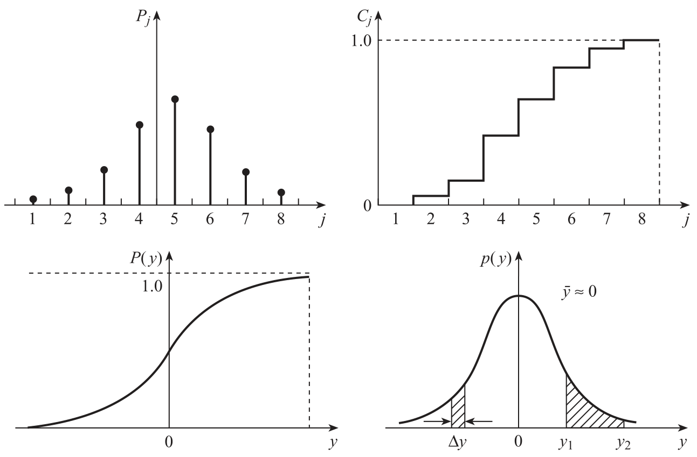
Probability Density Function Statistical Representation of Random Signals
Notes:
The probability function is check what the probability is, that a signal is in a certain range. This way the general behaviour of the system can be checked. If there are signals outside the range, the system can be adjusted to reduce the error.

Slide 9
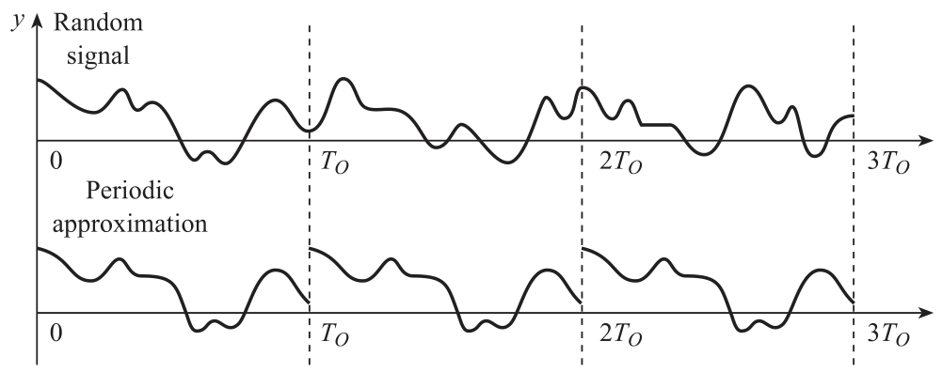
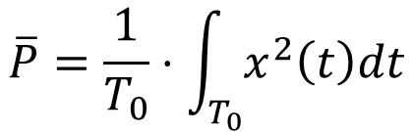
Power Spectral Density Statistical Representation of Random Signals
$$\overline{P}=\frac{1}{T_{0}}⋅\int_{T_{0}}^{ }{x^{2}\left(t\right)dt}$$
Notes:
The power of a signal, which is measured over a period of $T_{0}$, is used to quantify random signals.
It is stationary, meaning that the value won’t change over time, while the signal recordings can look differently.
The squared average of a signal is equal to the average power.
Power spectral density is a stationary quantity which is a measure of how the power in a random signal is distributed amongst these different frequencies.

Slide 10
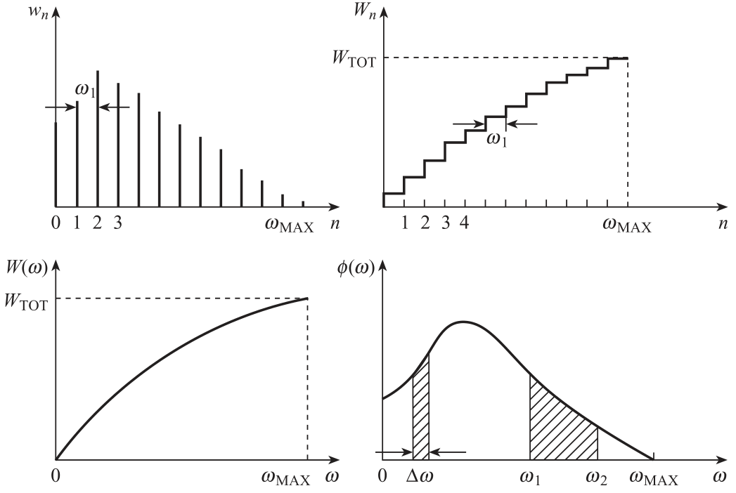


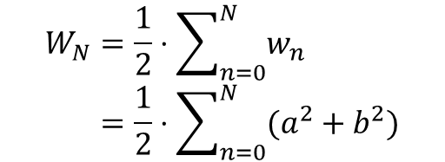
Power Spectral Density Statistical Representation of Random Signals
Total Power
$$W_{N}=\frac{1}{2}⋅\sum_{n=0}^{N}{w_{n}} \\ W_{N}=\frac{1}{2}⋅\sum_{n=0}^{N}{(a^{2}+b^{2})}$$
Cumulative Power (c.p.f)
$$W\left(ω\right)=\lim_{ω_{1}→0}{W_{n}}$$
Power Spectral Density
$$φ(ω)=\frac{dW}{dω}$$
Notes:
The power of a signal, which is measured over a period of $T_{0}$, is used to quantify random signals.
It is stationary (when the signal is also stationary over its period), meaning that the value won’t change over time, while the signal recordings can look differently.
The squared average of a signal is equal to the average power + using the fourier series, the signal’s power is distributed across the spectrum.
Power spectral density is a stationary quantity which is a measure of how the power in a random signal is distributed amongst these different frequencies.

Slide 11
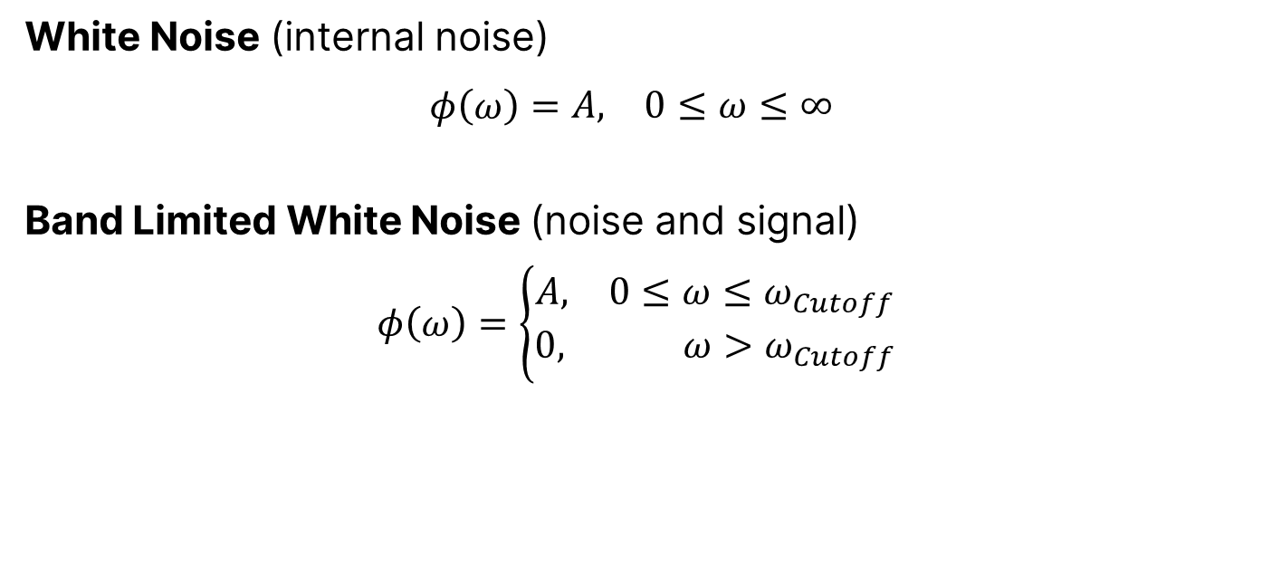
Power Spectral Density Statistical Representation of Random Signals
White Noise (internal noise)
$$φ\left(ω\right)=\begin{matrix}A, & 0≤ω≤∞ \end{matrix}$$
Band Limited White Noise (noise and signal)
$$φ\left(ω\right)=\left\{\begin{aligned}\begin{matrix}A, & 0≤ω≤ω_{Cutoff}\end{matrix} \\ \begin{matrix}0, & ω>ω_{Cutoff}\end{matrix}\end{aligned}\right.$$
Notes:
White noise, which is internal noise in electronics, can be represented as a constant amplitude over
Band Limited White Noise is good for representing noise and measurement signals! → cut off frequency

Slide 12
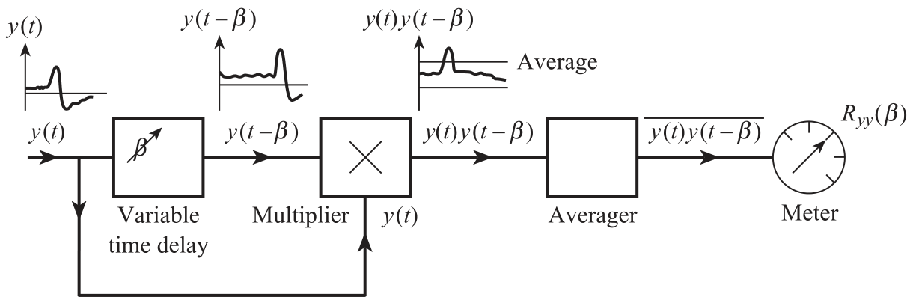
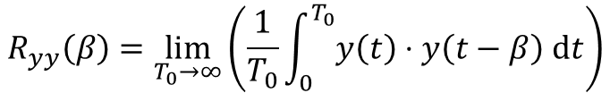
Autocorrelation Statistical Representation of Random Signals
$$R_{yy}\left(β\right)=\lim_{T_{0}→∞}\left(\frac{1}{T_{0}}\int_{0}^{T_{0}}{y\left(t\right)⋅y\left(t−β\right) dt}\right)$$
Notes:
Autocorrelation can be used to calculate delays between an input and output of a system.
The autocorrelation has the same frequency as the signal itself!

Slide 13
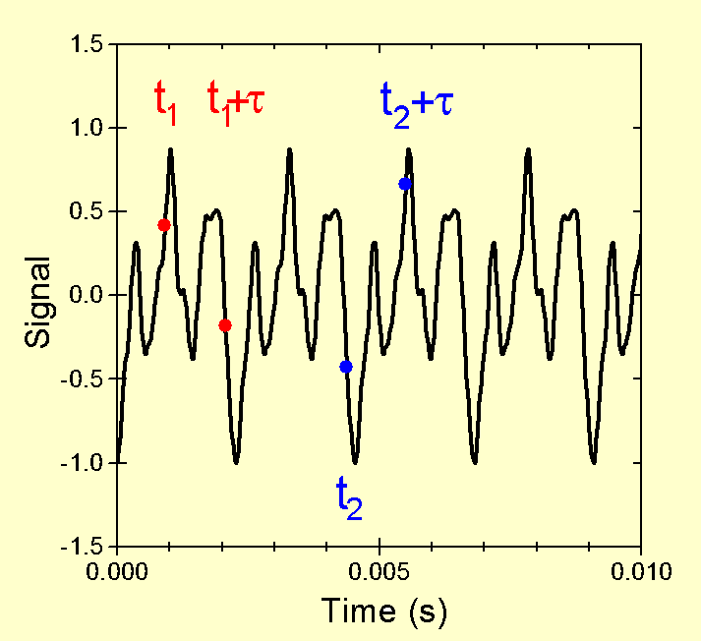
Autocorrelation Statistical Representation of Random Signals
Detecting Periodicity
Estimating Signal Properties
https://pages.mtu.edu/~suits/autocorrelation.html
Notes:
Autocorrelation can be used to calculate delays between an input and output of a system.
The autocorrelation function of any periodic signal has the same period as the signal itself
Usage
Find period of signal by analysing peaks
Find rms value by setting delay to 0

Slide 14
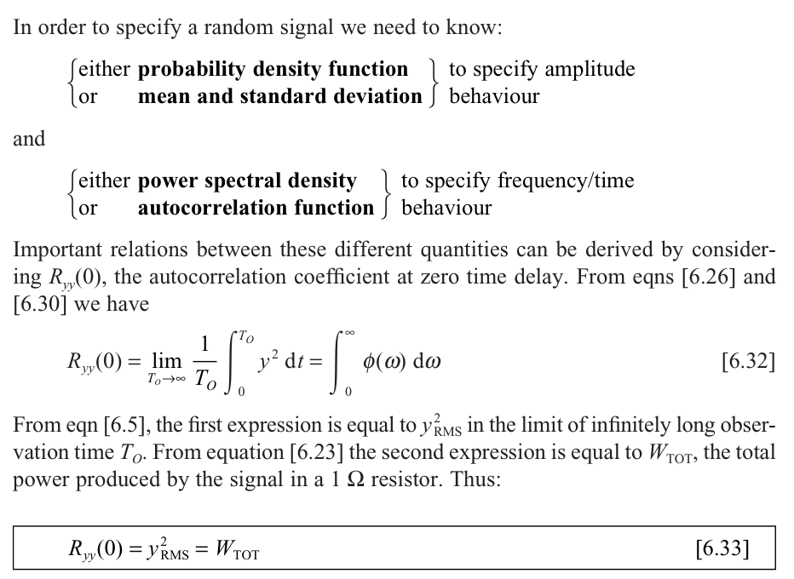
Autocorrelation Statistical Representation of Random Signals
Notes:
Autocorrelation can be used to calculate delays between an input and output of a system.
The autocorrelation function of any periodic signal has the same period as the signal itself

Slide 15
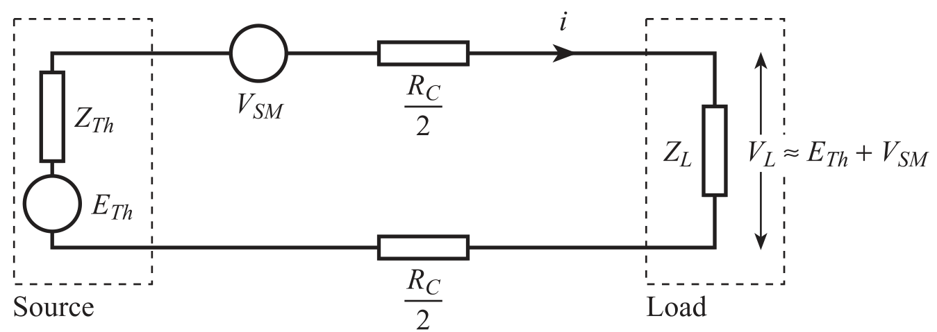
Voltage transmission – series mode interference Effects of noise and interference on measurement circuits

Slide 16
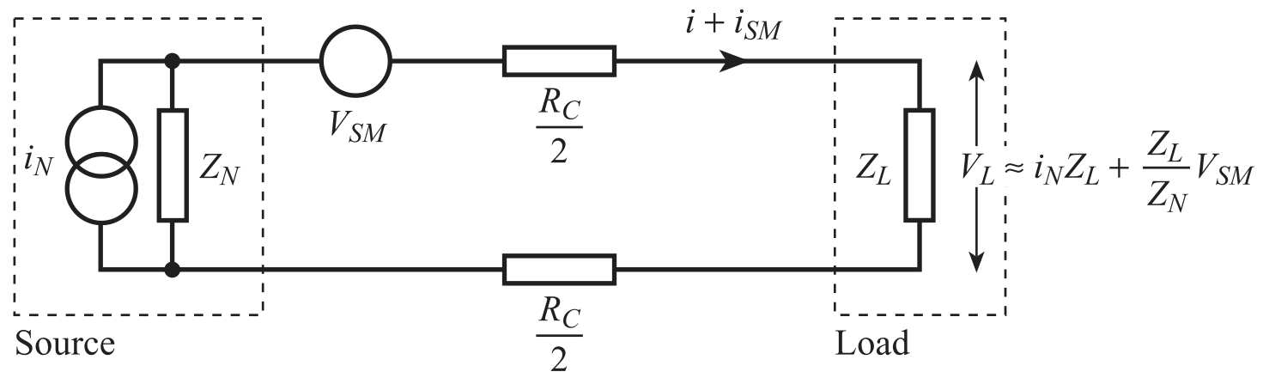
Current transmission – series mode interference Effects of noise and interference on measurement circuits

Slide 17
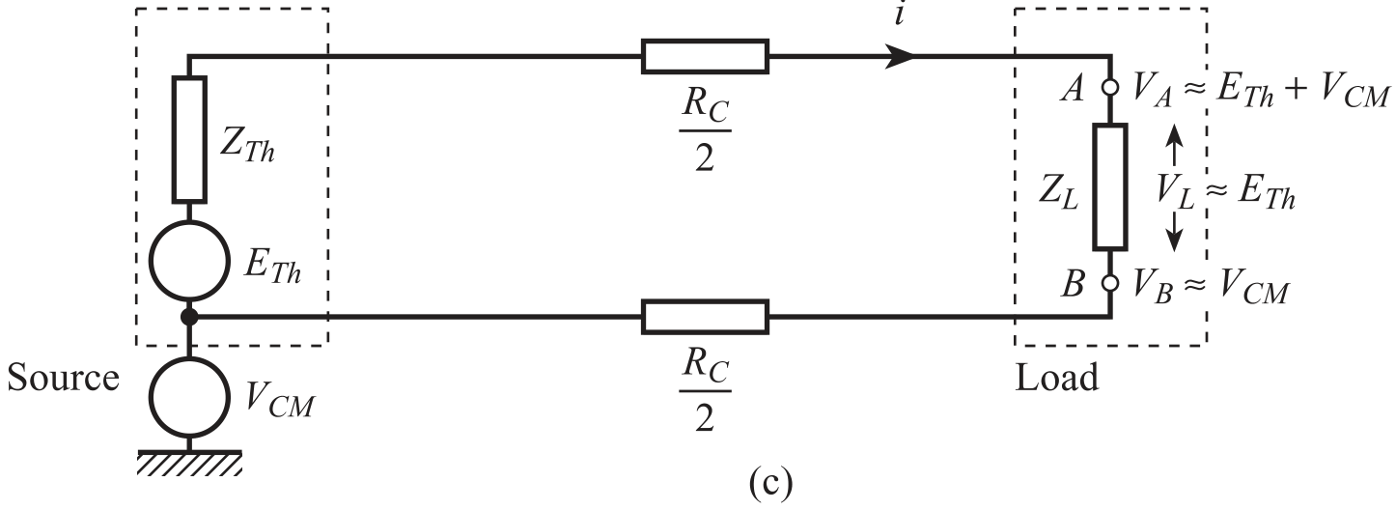
Voltage transmission – common mode interference Effects of noise and interference on measurement circuits

Slide 18

Signal to Noise Ratio (SNR) Effects of noise and interference on measurement circuits
$$SNR=\frac{S}{N}=20⋅\log_{10}\left(\frac{E_{Th}}{V_{SM}}\right)=20⋅\log_{10}\left(\frac{W_{S}}{W_{N}}\right)[dB]$$
Notes:
All values are in RMS

Slide 19
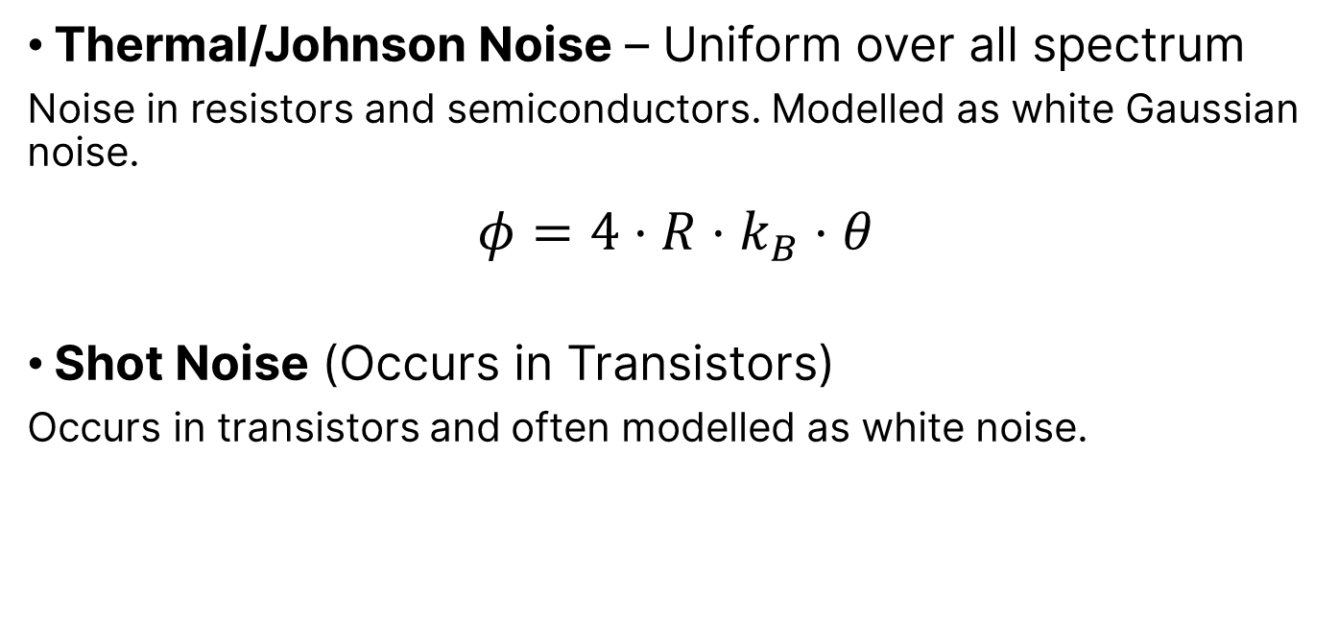
Noise Sources
Thermal/Johnson Noise – Uniform over all spectrum
Noise in resistors and semiconductors. Modelled as white Gaussian noise.
$$φ=4⋅R⋅k_{B}⋅θ$$
Shot Noise (Occurs in Transistors)
Occurs in transistors and often modelled as white noise.
Notes:
Thermal noise is

Slide 20
External Noise Sources
AC Sources – most common interference
for example 230V, 50Hz
DC Sources – Switching signals, impulses
RFI – Radio frequency from oscillators
Notes:
AC Sources are the most common type of interferences, as the changing signals influence measurement circuits and nearby circuits. A good example is 230V + 50Hz (main power)
DC Sources themselves don’t interfere with circuits (except for maybe electrical fields), but the changing states of these DC signals create interferences.
RFI: oscillators in radio frequency transmitters and receivers → can get picked up by nearby circuits of the system

Slide 21
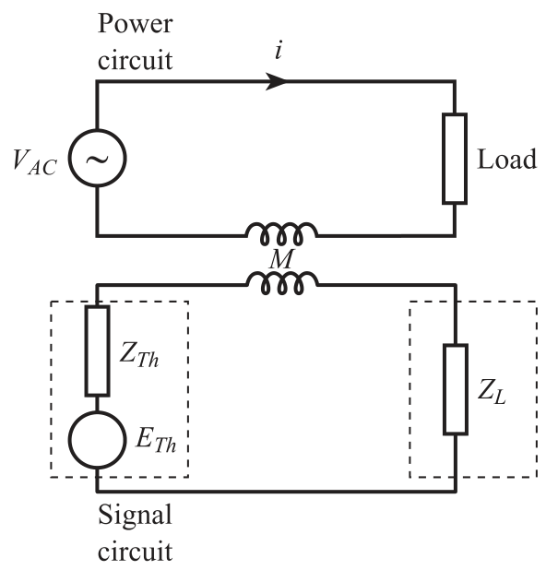
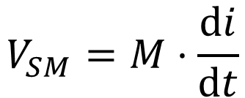
Inductive Coupling Coupling Mechanism
$$V_{SM}=M⋅\frac{di}{dt}$$
Notes:
M: Mutual inductance

Slide 22
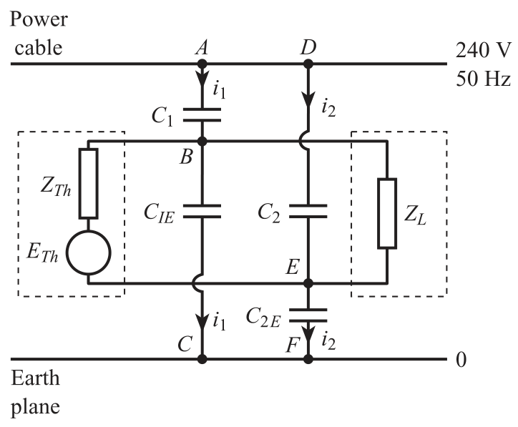
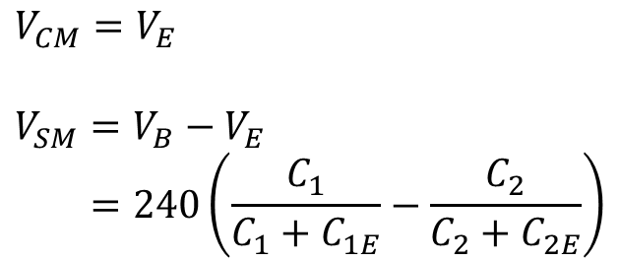
Capacitive Coupling Coupling Mechanism
$$V_{CM}=V_{E}$$
$$V_{SM}=V_{B}−V_{E}$$
$$V_{SM}=240\left(\frac{C_{1}}{C_{1}+C_{1E}}−\frac{C_{2}}{C_{2}+C_{2E}}\right)$$
Notes:
No interference when C1=C2, C1e=C2e

Slide 23
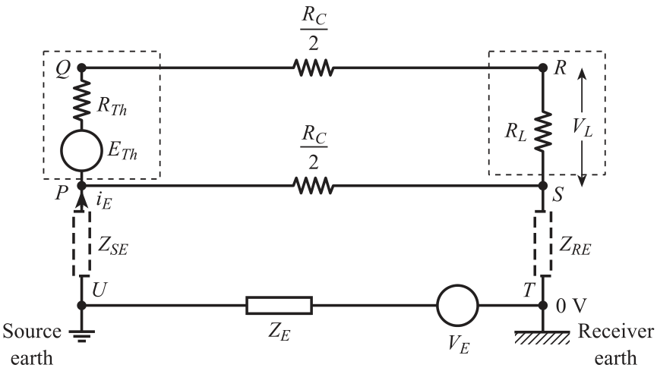
Multiple Earths Coupling Mechanism

Slide 24
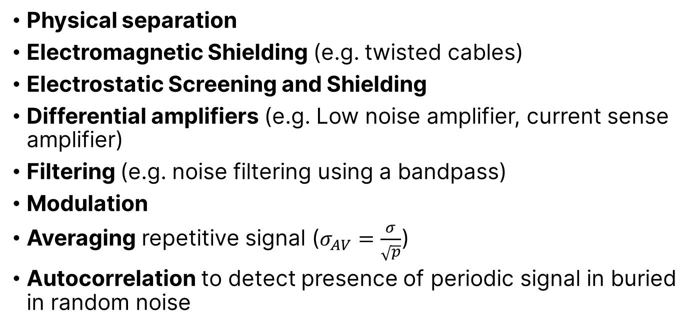
Noise Reduction Methods
Physical separation
Electromagnetic Shielding (e.g. twisted cables)
Electrostatic Screening and Shielding
Differential amplifiers (e.g. Low noise amplifier, current sense amplifier)
Filtering (e.g. noise filtering using a bandpass)
Modulation
Averaging repetitive signal ($σ_{AV}=\frac{σ}{\sqrt{p}}$)
Autocorrelation to detect presence of periodic signal in buried in random noise

